Slide 1
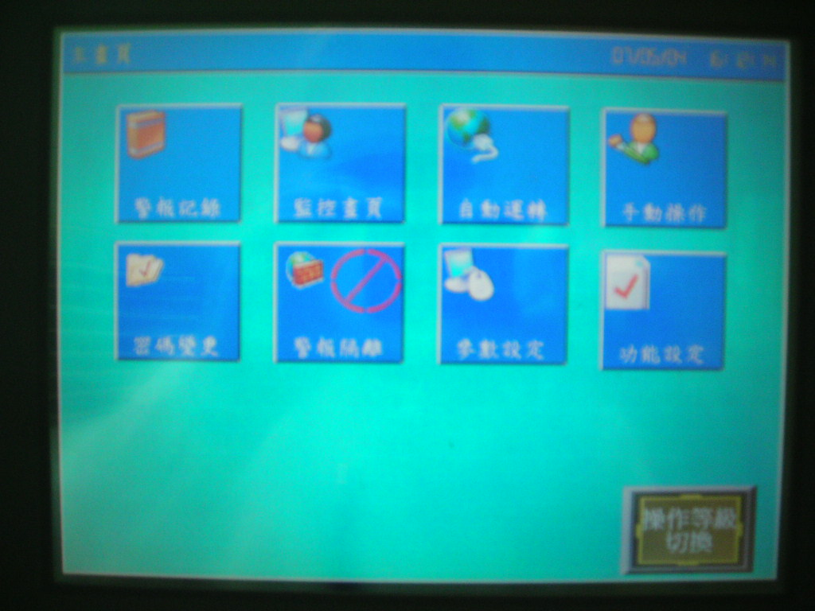
主畫面
按下操作等級

Slide 2
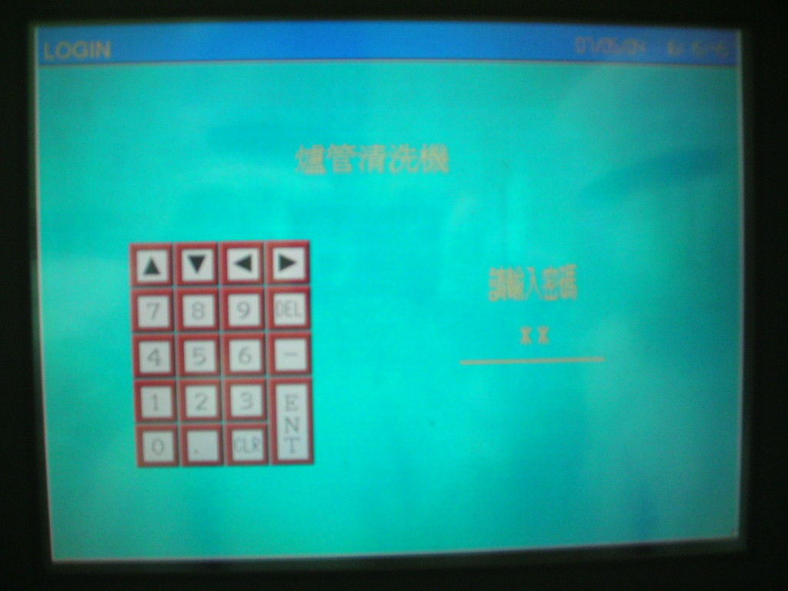
按一下字體就會閃爍便可輸入密碼
密碼:1111(洗管人員)2222(工程師)3333(機台負責人)

Slide 3
按下自動運轉

Slide 4
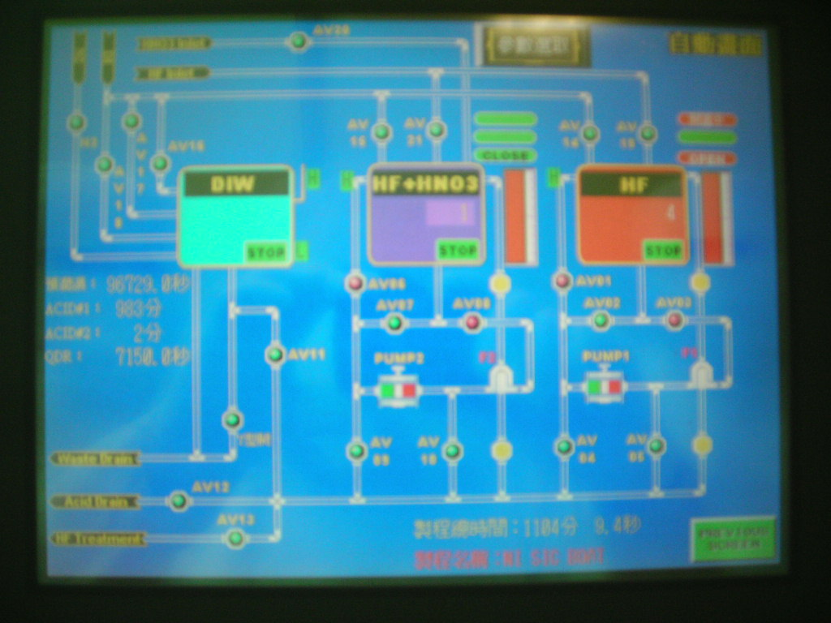
按下參數選取

Slide 5
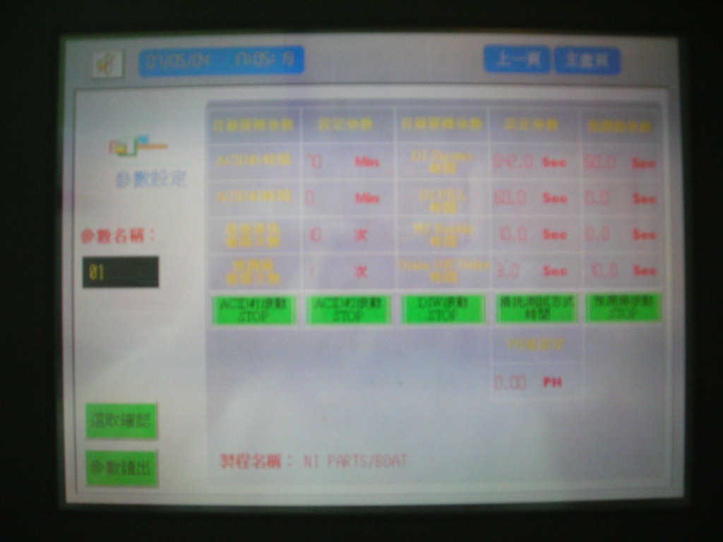
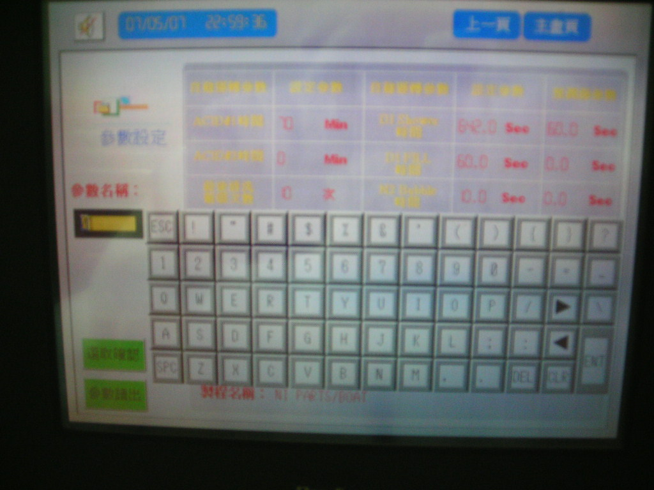
1. 按下參數名稱點資料如:
表1
5.回主畫面
4.名稱正確再按此鍵約2秒
2.選完參數要按此鍵約2秒
3.此時會顯示正確名稱

Slide 6
按下自動運轉

Slide 7
1.此時將會顯示製成總時間及製程名稱

Slide 8
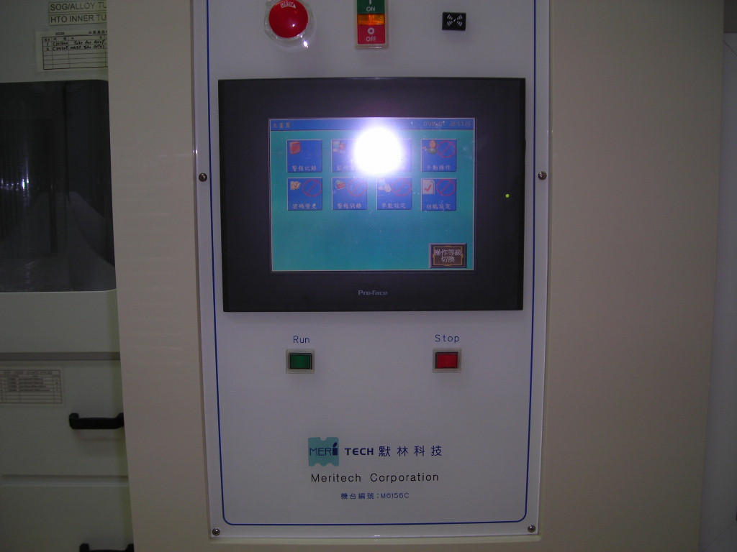
按下 RUN 就可清洗

Slide 9
表1
TANK | Acid mix | 程式編號 | 清洗程式名稱 | DI clean (step 1) | Acid clean(step 2) | DI clean(step 3)
BATH-1 |  | 1 | Nitride parts/boat | 2 min(120sec) | 70min | 107min(6420 sec)
 | HF 60% | 2 | Nitride sic boat | 2 min(120sec) | 1130min | 107min(6420 sec)
 | DI water 40% | 3 | Nitride tube | x | 70min | 107min(6420 sec)
 |  | 4 | Teos parts/boat | 2 min(120sec) | 50min | 107min(6420 sec)
 |  | 5 | Teos tube | x | 50min | 107min(6420 sec)
BATH-2 | HF 11% | 6 | Poly parts | x | 70min | 107min(6420 sec)
 | HNO3 56% | 7 | Poly sic boat | 2 min(120sec) | 140min | 107min(6420 sec)
 | DI water 33% | 8 | Poly tube | x | 70min | 107min(6420 sec)
BATH-3 | DI water 100% | 9 | DI water parts | 107min(6420 sec) | x | x
 |  | 10 | DI water tube | 107min(6420 sec) | x | x

